Slide 1

Collaborated Editing on ODF
Svante.Schubert@gmail.com

Slide 2
Who am I
Svante Schubert
  Started 1999 at Sun Microsystems, later Oracle
  Freelancer on Standardization / File Format Software
  Apache Incubator ODF Toolkit (Committer/PPMC)
  Chair of OASIS Advanced Document Collaboration SC
Notes:
Chairing the OASIS ODF Advanced Collaboration Sub-Committee
https://www.oasis-open.org/committees/tc_home.php?wg_abbrev=office-collab
Biography on LinkedIn:
http://www.linkedin.com/profile/view?id=6765517&trk=tab_pro
NEXT: Why OASIS SC? Change-tracking PROBLEM!

Slide 3
Change-Tracking (CT) Interoperability
ODF with Microsoft Offices (MSO)
All MSO throw away all ODF changes
  MS claims ODF underspecified for change-tracking (template styles)
  No subset implemented in MSO, instead everything ignored
  No business document ping-pong possible between LO/AO and MSO
  Problem Solution: Fix of specification for ODF 1.3
Notes:
Why will a fix help?

Slide 4
Standard Importance
Microsoft ODF promise to EU
“Microsoft’s Primary PC Productivity Applications shall support the ODF Standard … for ten years from the effective date of this Undertaking, within 9 months of final publication by ISO of a new ODF Standard Microsoft shall support that version..”
http://www.microsoft.com/en-us/news/press/2009/dec09/12-16statement.aspx
Notes:
http://www.microsoft.com/en-us/news/press/2009/dec09/12-16statement.aspx
http://www.microsoft.com/en-us/news/presskits/eu-msft/docs/microsoftinteroperabilityundertaking16dec2009.doc
“Microsoft’s Primary PC Productivity Applications shall support the ODF Standard … for ten years from the effective date of this Undertaking, within 9 months of final publication by ISO of a new ODF Standard Microsoft shall support that version..”
FIELDS from DOC saved as some proprietary XML, will not be loaded in next MS OFFICE Version!
WAIT! ISO earlier OASIS? What is the difference?

Slide 5
Standard in a Nutshell
OASIS / ECMA
  OASIS / ECMA standardization have company members
  OASIS / ECMA lead by industry for global usage
  OASIS / ECMA comparable easy to evolve a standard
ISO (International Organization for Standardization)
  Slogan after II. World War: "World Peace through World Trade"
  ISO is an international organization of national standardization groups (National Bodies)
  Government may influence National Bodies
  ISO “de jure”/ may dictate usage by law
Notes:
Answers:
1) Why are there TWO standards for ODF?
2) Why is ISO so much more important?

Slide 6
Summary: Reason of a Standard
Blueprint for ODF applications
Base for Office Interoperability
Independent place to settle disagreements (OASIS list)
Leverage to get ODF implementation in MSO
Notes:
Remarks:
1-3) Remember that there are other ODF applications out there
AO vs. LO discussion sometimes reminds on “Life of Brian's” struggle between:
Judean People's Front,
People's Front of Judea,
4) User has high(er) expectations
BENEFIT OF ODF

Slide 7
CT Interoperability:
ODF and OOXML
Problem of ODF change-tracking
  Not caused by the difference of OOXML and ODF
  Not caused by OOXML feature superset
  Caused by underspecification in ODF (Style & Table changes)

Slide 8
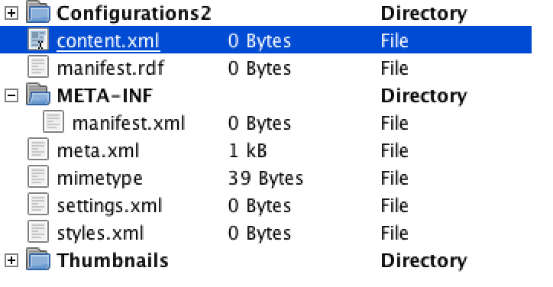
ODF Details
ODF document:
  Shock frozen state of a “living document”
  Directory within ZIP file container
  Contains content.xml (or styles.xml) as minimum

Slide 9
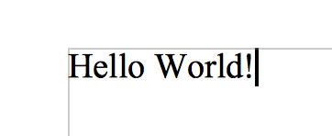
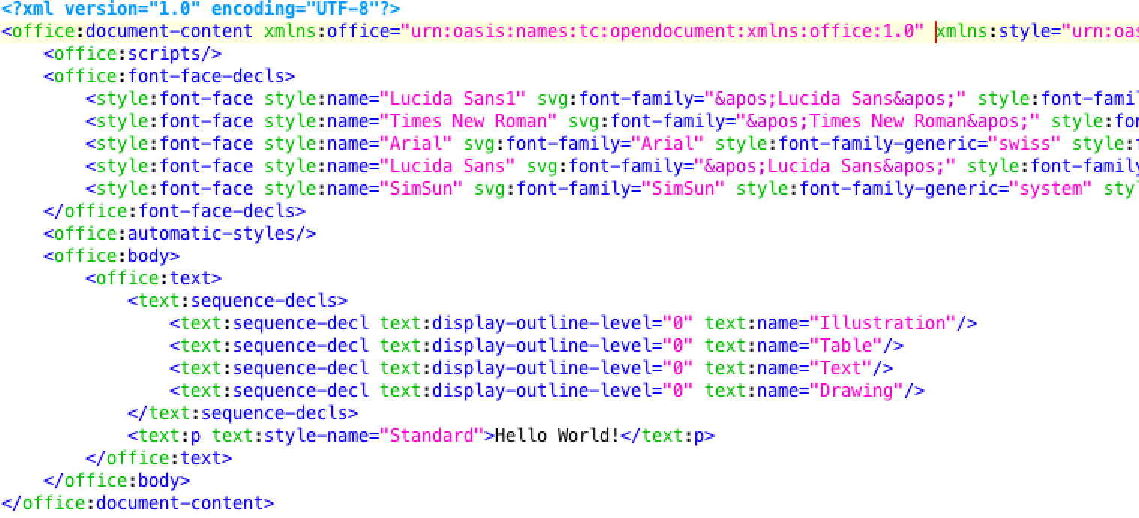
ODF Details (content.xml)
Sure, could be less boilerplate..
Notes:
Why HEADER/BODY in a multipart file?
Convention over Configuration – define an EMPTY document

Slide 10
Flaws of current
Change-Tracking
Notes:
As Microsoft claimed the current ODF change-tracking being broken, let's try out OOXML change-tracking (using MS Office 2011 on a Macbook)

Slide 11
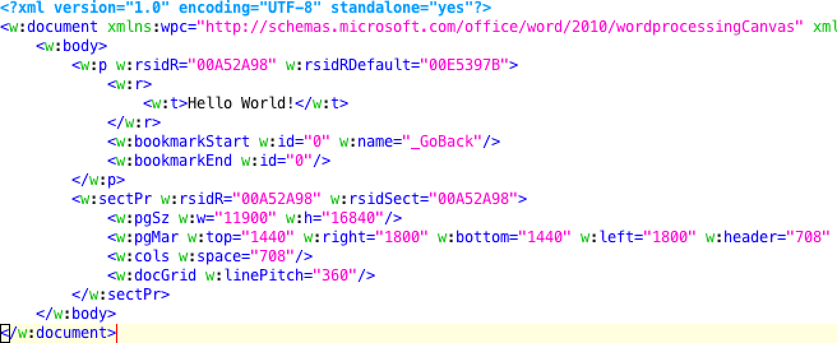
OOXML Details (document.xml)
Similar boilerplate..
Notes:
Why HEADER/BODY in a multipart file?
Convention over Configuration –
We should define an EMPTY document for ODF & OOXML.

Slide 12
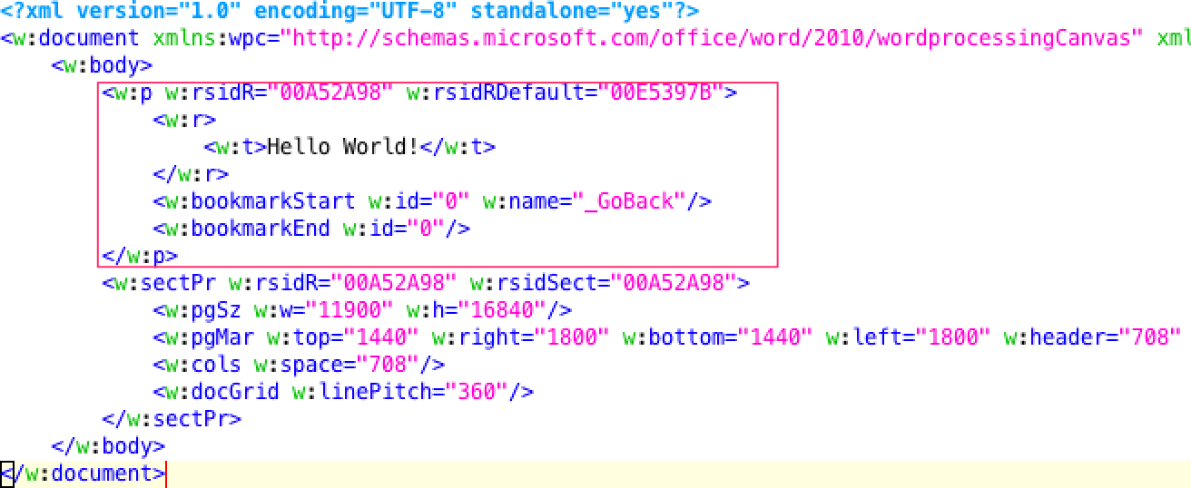
OOXML Details (document.xml)
Similar boilerplate..

Slide 13
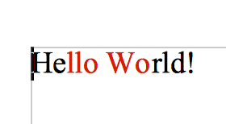
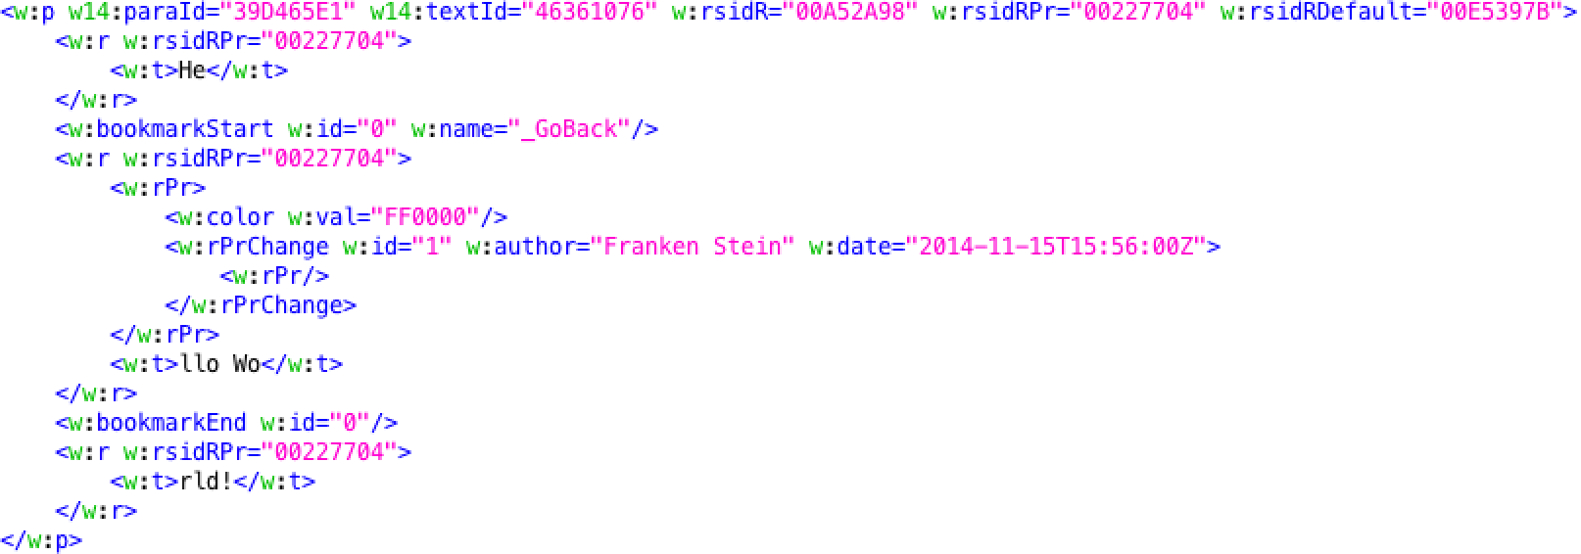
OOXML Change-Track Details
Change-tracked text format..

Slide 14
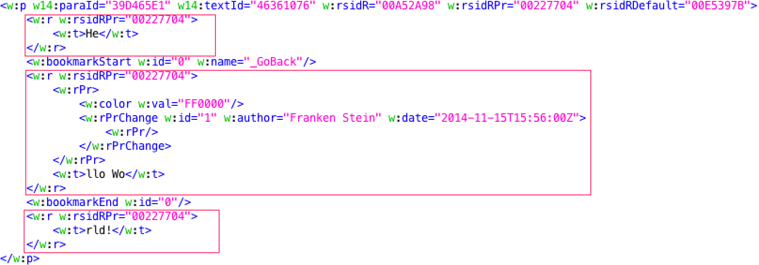
OOXML Change-Track Details
Change-tracked text format..

Slide 15
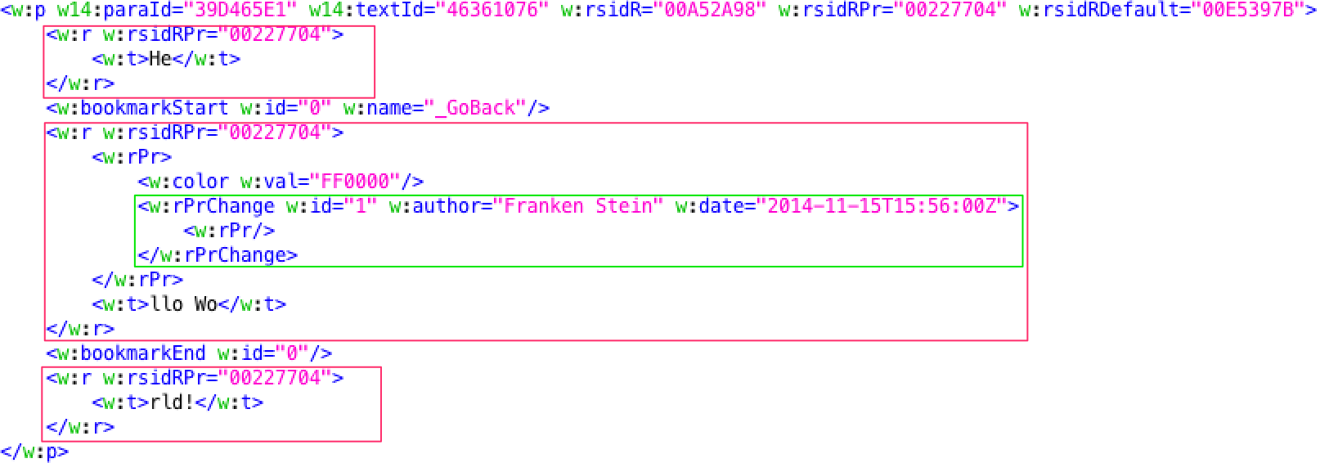
OOXML Change-Track Details
Change-tracked text format..
Before State
Notes:
The gree is the BEFORE STATE being used, when rejecting the changet

Slide 16
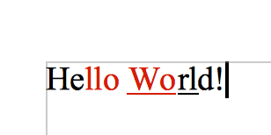
Status Quo: Change-Tracking
Users does a “change reject”
  Reanimates state of “before state box”
Problematic with overlapping Changes
  Reanimation not sufficient in case of dependencies
  Reanimated state influences content of other “before state box”
DEMO – Downside old concept - MS Office 2011 on Mac

Slide 17
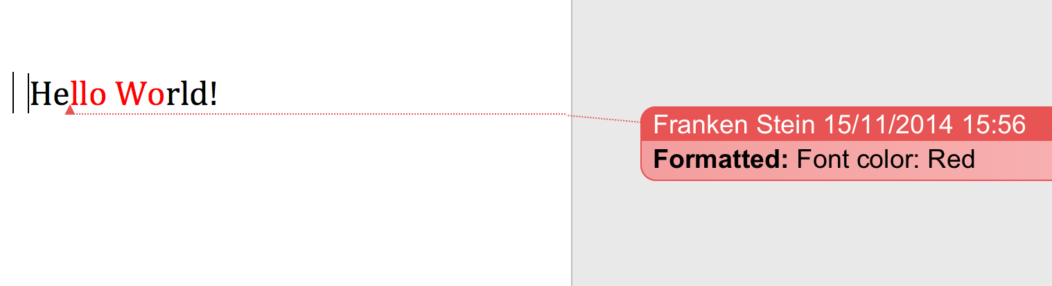
Demo: MS Office2011 Mac
Change 1: Format substring “llo Wo” red

Slide 18
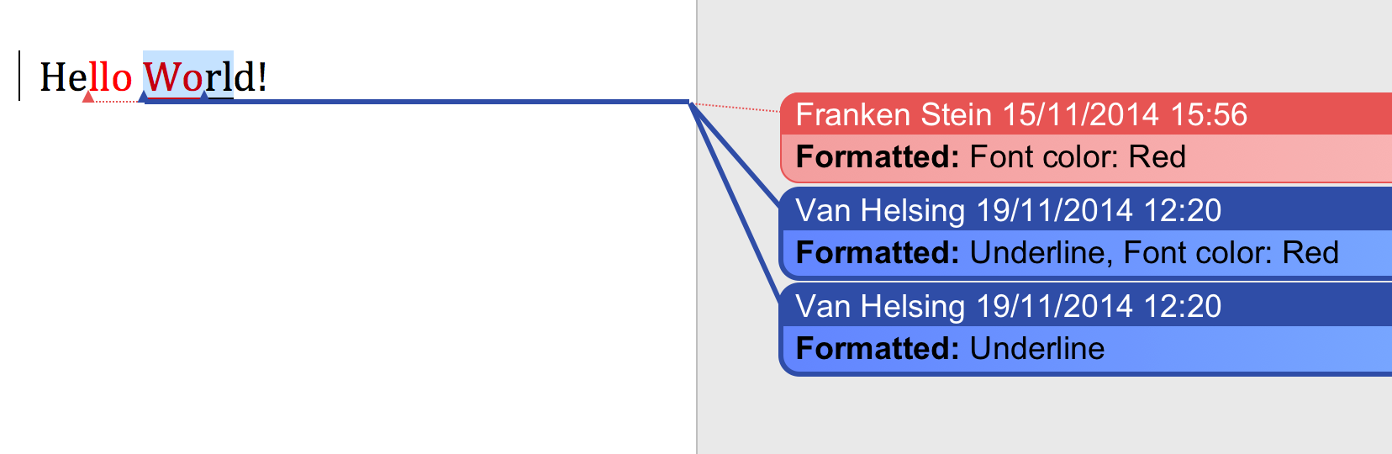
Demo: MS Office2011 Mac
Change 2: Format substring “Worl” underline
Why are there two changes for 1 Change?

Slide 19
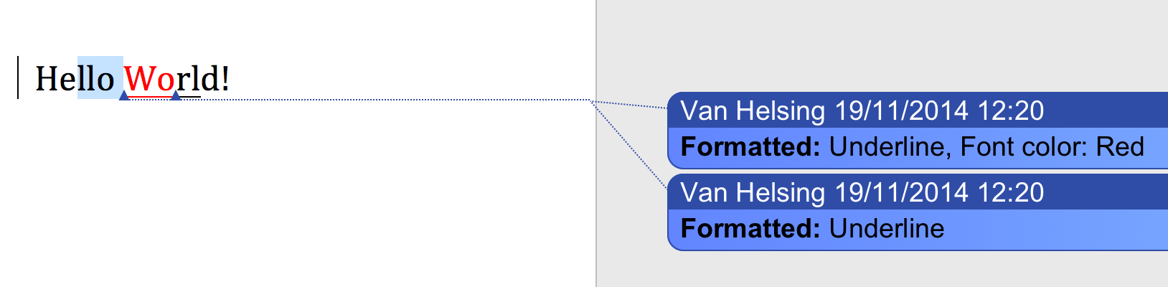
Demo: MS Office2011 Mac
Change 3: Undo first Change (no red format) → Broken!
Why is there still red format?

Slide 20
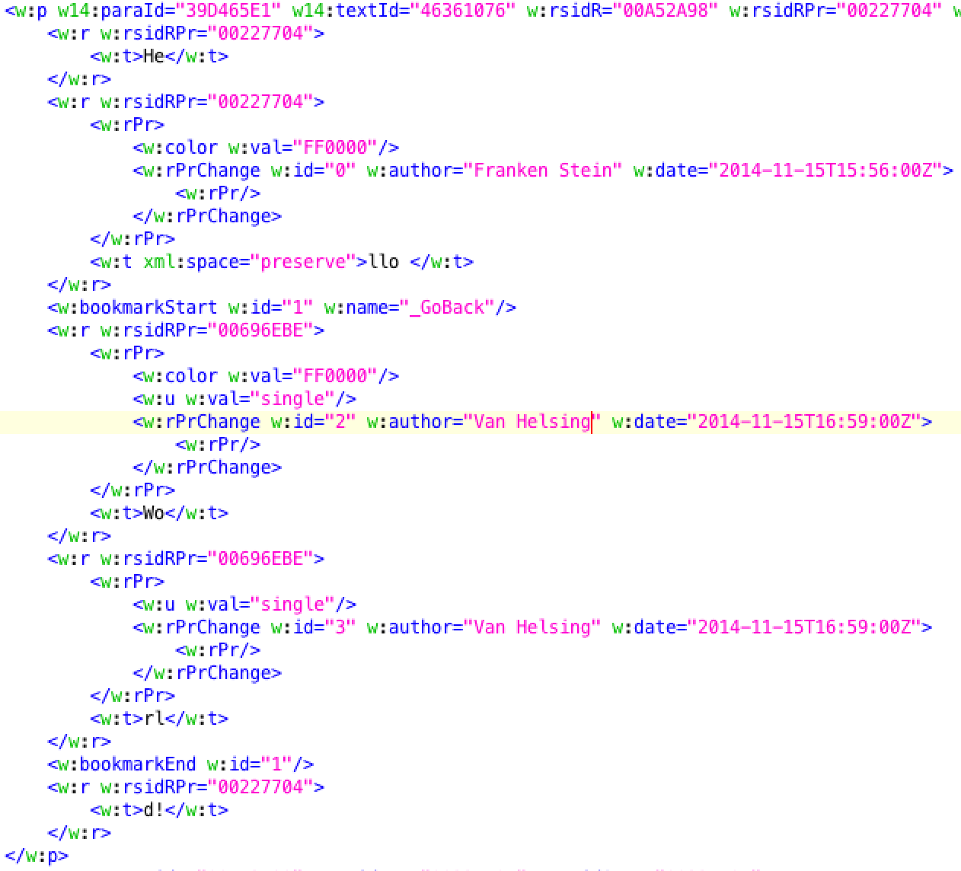
OOXML Change-Track Details
Change-tracked text format..

Slide 21
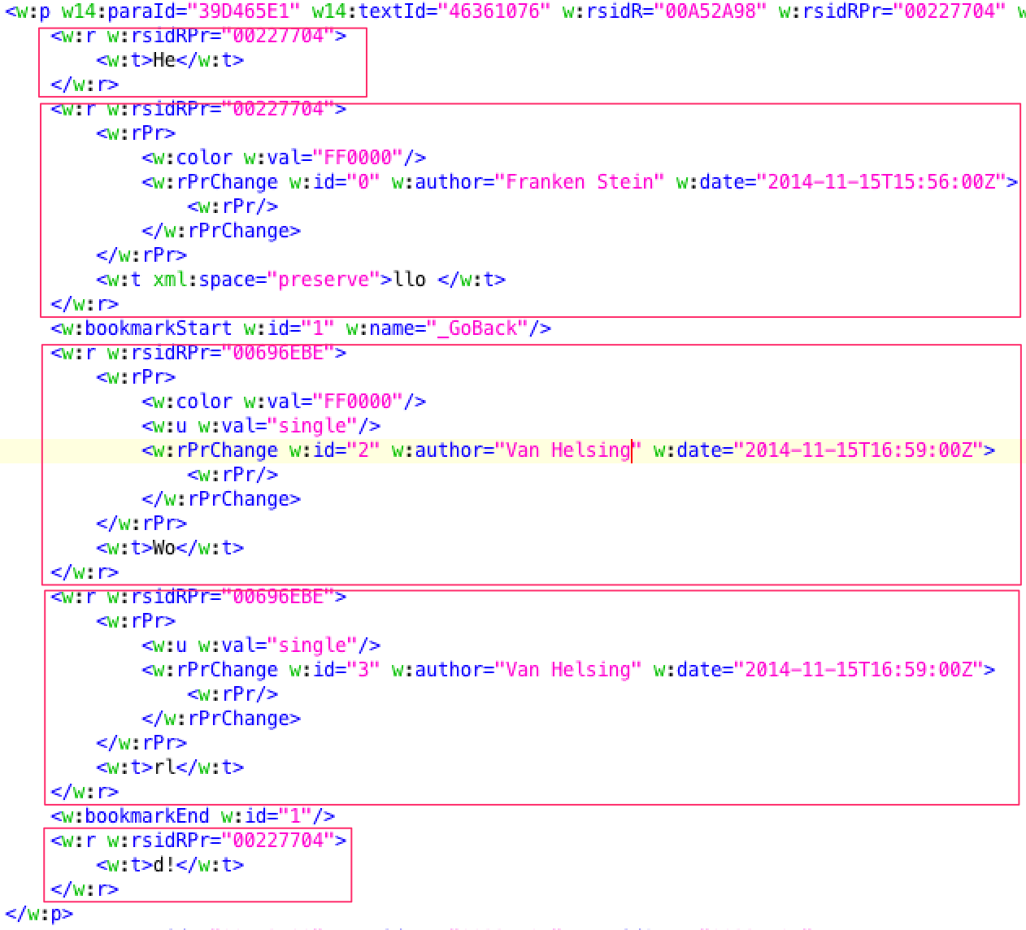
OOXML Change-Track Details
Change-tracked text format..

Slide 22
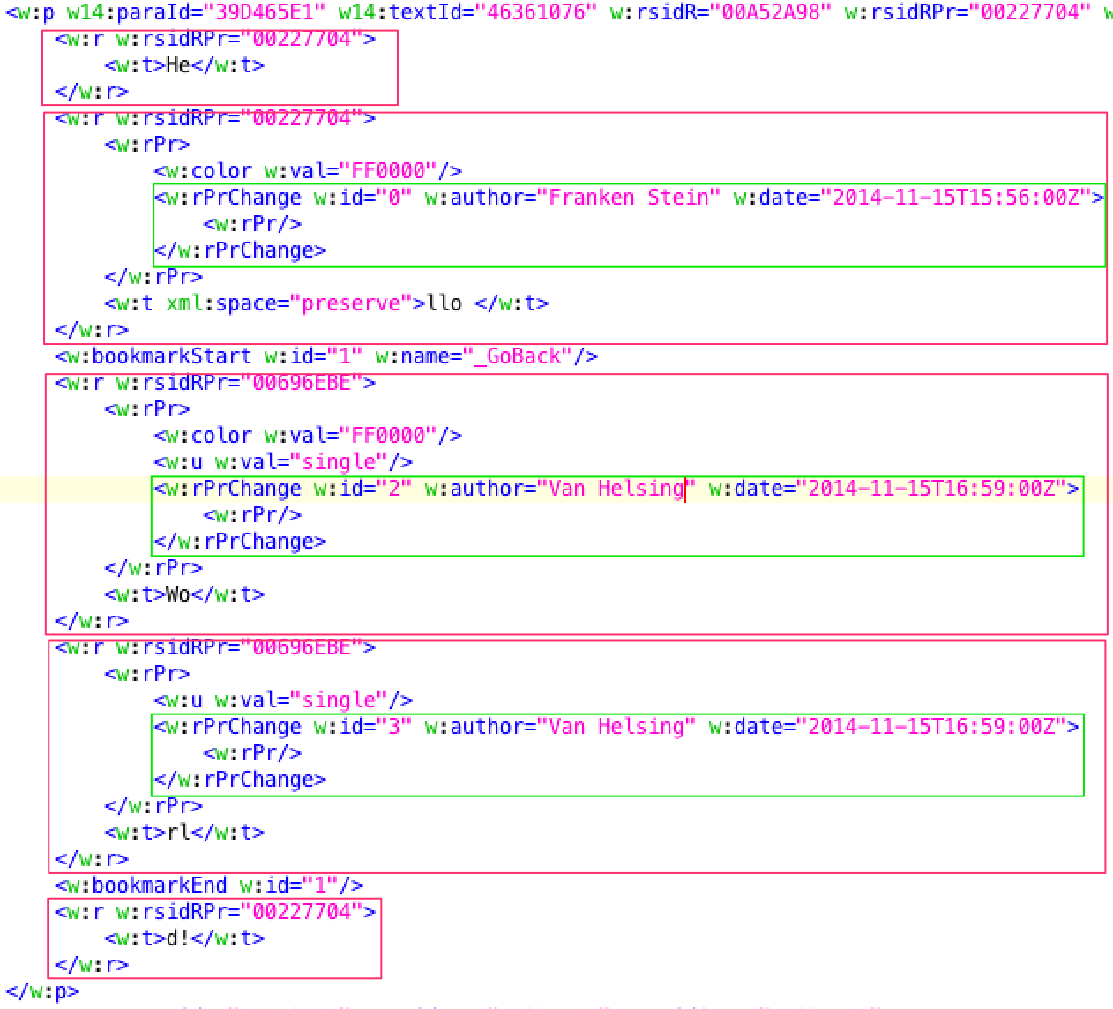
OOXML Change-Track Details
Change-tracked text format..

Slide 23
Alternatives?
Notes:
COUNTING ONLY THE COMPONENTS
NO BOILERPLATE

Slide 24
Use “changes” for change-tracking!
Notes:
Strange: Earlier doing change-tracking without knowing what a change is! :D

Slide 25
Change what?
Question:
How can office applications with different internal model...
  Exchange their model changes?
  Save in the end the same document?
Notes:
Most ODF apps designed for floppy discs not for Internet
Similar to source programming not real-time editing is required (necessarily), but ability to exchange changes via efficient patches (work asynchronous on large documents)
Desired so there is the ”ODF Advanced Document Collaboration” subcommittee - https://www.oasis-open.org/committees/tc_home.php?wg_abbrev=office-collab
We simplify the ODF XML by abstracting the existing model

Slide 26
Change what?
Question:
How can office applications with different internal model...
  Exchange their model changes?
  Save in the end the same document?
Answer:
  Simplified Virtual Model
  Similar as humans would explain the location
Notes:
Most ODF apps designed for floppy discs not for Internet
Similar to source programming not real-time editing is required (necessarily), but ability to exchange changes via efficient patches (work asynchronous on large documents)
Desired so there is the ”ODF Advanced Document Collaboration” subcommittee - https://www.oasis-open.org/committees/tc_home.php?wg_abbrev=office-collab
We simplify the ODF XML by abstracting the existing model

Slide 27
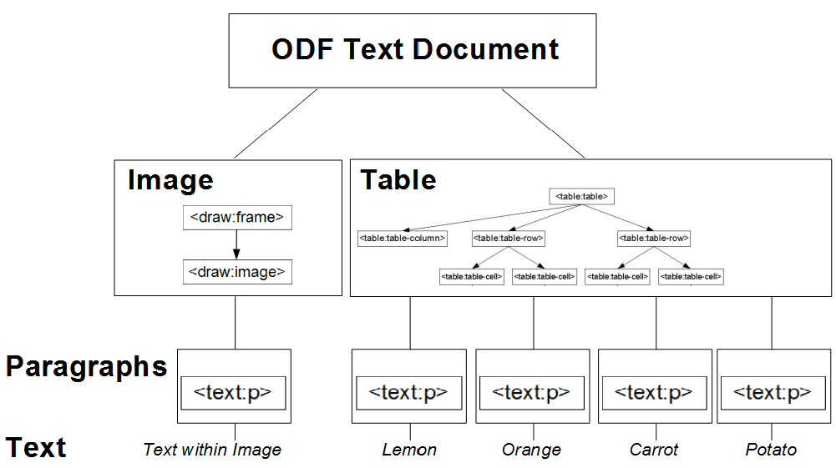
Logical XML groups (Components)
Notes:
The model is the specification, but even the ODF 1.2 part 1 is listing
~600 elements / ~1300 attributes
Find logic puzzle pieces (components) based on user logic. Separate XML grammar tree on user logic and common user changes.
Rules of data encapsulation. Altering the component does not change anything outside the component.
Views – like content table (indices), table collections like row, column, cellranges..
NOTE: Table on graphic is simplified. Rows are a component as well.

Slide 28
Document equal to the Sum of Changes
The “Hello World” for ODF/OOXML could be
  <add type=”paragraph” start=”/1” />
  <add type=”text” start=”/1/1”>Hello World!</add>
Or in one operation
  <add type=”paragraph” start=”/1”>Hello World!/>
DEMO – Web Office based on Changes
  Apache Incubator ODF Toolkit in backend (for now just a fork)
Notes:
COUNTING ONLY THE COMPONENTS
NO BOILERPLATE
Using consistent model of changes for interchange of user actions/documents!

Slide 29
Example: OOXML/ODF Changes as JSON
Undoing the change:
  {"name":"format","start":[1,7],"end":[1,10],
  "attrs":{"text":{"underline":null}}},
  {"name":"format","start":[1,3],"end":[1,7],
  "attrs":{"text":{"color":null}}}
Notes:
JSON being exchanged between Apache ODF Toolkit Incubator mapping an ODF to JSON Operations
Every BrowserEdit becomes a JSON operation as well.
Will be dispatched back to server, when document is being closed or downloaded.

Slide 30
Example: OOXML/ODF Changes as JSON
Undoing the change (inverse operation):
  {"name":"format","start":[1,7],"end":[1,10],
  "attrs":{"text":{"underline":null}}},
  {"name":"format","start":[1,3],"end":[1,7],
  "attrs":{"text":{"color":null}}}
Doing the change:
  ﻿{"name":"addText","start":[1,0],"text":"Hello World!"}
  {"name":"format","start":[1,3],"end":[1,7],
  "attrs":{"text":{"color":{"type":"rgb","value":"FF0000"}}}},
  {"name":"format","start":[1,7],"end":[1,10],
  "attrs":{"text":{"underline":true}}},
Notes:
Every Operation has an INVERSE operation that UNDO it. Putting the document in the previous state!

Slide 31
Limitations
Possible conflicts..
  One is working on a table cell, the other removed the table
  Text of first and last paragraph different, but redundant with same meaning
  Different names being used for the receiver of the love letter
Notes:
Automate what can be automated
Abstract the technique from the user
STILL the above can & will happen!

Slide 32
Operations as Lingua Franca?
Notes:
To make equal again what went different ways in the past..

Slide 33
Operations: Lingua Franca of Documents
Decouple Transformation Complexity:
ODF
OOXML
Operations
HTML
Docbook
...
Notes:
Operations/Changes can become a lingua franca creating a bridge between redundant standards.
Defining changes to be dispatched among document users.
Writing 10 years on a XSL transformation from ODF to HTML. Common problem was the problem in understanding of ODF or HTML? Able to reuse transformation from (or to) a format to ops and combine it differently.
Special features of a format will be ignored in the operation queue (kept in the queue) and can therefore be round-tripped!
XSLT PROCESSING – INTERLEAVED MAPPING & IMPLEMENTATION

Slide 34
Reuse of
Change Design
Notes:
Software modules can be reused..
As Apache ODF Toolkit (Incubating) for testing purposes..

Slide 35
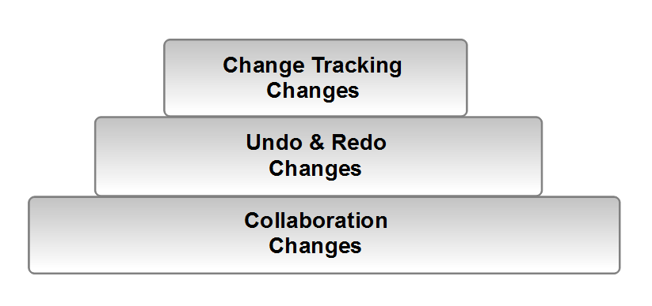
Relationship of Changes
Notes:
Finest granularity for Real-Time-Collaboration (bottom), required is change-tracking for ODF 1.3.
Aggregation of commands
STARTING FROM THE BOTTOM: Collaboration might dispatch every character change...
Undo & Do aggregation of Collaboration changes:only for one for user, usually not single character but undo/do by word granularity. Not saved in ODF.
Change Tracking further aggregation: Only the aggregated changes of user changes to previous state. In-between changes are not tracked.
AO/LOO DIFFERENT CT & UNDO IMPLEMENTATION

Slide 36
ODF Interoperability / Next Feature Set
ODF Document Interoperability (covered)
  ODF Applications exchange documents via Floppy Disc (Mail)
ODF Change Interoperability (desired)
  ODF Applications exchange changes via Net
Notes:
Most ODF apps designed for floppy discs not for Internet
Similar to source programming not real-time editing is required (necessarily), but ability to exchange changes via efficient patches (work asynchronous on large documents)
Desired so there is the ”ODF Advanced Document Collaboration” subcommittee - https://www.oasis-open.org/committees/tc_home.php?wg_abbrev=office-collab
We simplify the ODF XML by abstracting the existing model

Slide 37
Document Interoperability by Changes
Earlier: Black Box Change Handling
  ODF 1.0 to 1.2: Before/After XML subtree
  Application used “forensic” diff to identify change (e.g. move row)
Now: Specifying Changes
  Applied on a logical standardized component (e.g. image, table, character)
  State (ODF XML) transition from one valid state to another
  Basic changes: Add/Delete/Modify (and Move/Replace)
  Ability to resolve dependencies by Operational Transformation (OT)
  Every Operation's position relative to current document state
  Movement of Operation withing List is like changing execution time
Notes:
Move the complexity in the specification not into the file format
Also: Define reoccurred change pattern: Split/MergeParagraph, insertColumn,..
Able to adapt change within queue of dependent changes (OT)

Slide 38
Any Document equal to Change List
Document with “A” Content
add A @1 ← <CHANGE> <SOMETHING> <SOMEWHERE>

Slide 39
Change List
Document with “AB” Content
add A @1
add B @2

Slide 40
Change List
Document with “ABC” Content
add A @1
add B @2
add C @3

Slide 41
Change List
Document with “ABC” Content
add A @1 add C @1
add B @2
add C @3

Slide 42
Change List
Document with “ABC” Content
add A @1 add C @1
add B @2 add B @1
add C @3

Slide 43
Change List
Document with “ABC” Content (two ways doing the same)
add A @1 add C @1
add B @2 add B @1
add C @3 add A @1
Notes:
User can add the SAME document adding in sequence “ABC” or adding “C” and moving always the cursor back twice and finally end up with the same “ABC”.
Two change list that result into same document are EQUAL!

Slide 44
Change List
Document with “ABC” Content
add A @1 add C @1 add C @1
add B @2 add B @1 add B @1
add C @3 add A @1 add A @1

Slide 45
Change List
Document with “ABC” Content
add A @1 add C @1 add C @1
add B @2 add B @1 add A @1
add C @3 add A @1 add B @2
Notes:
Whenever something was added before the index goes up.
Analogue index goes down for delete and for entities add/removed up in the tree.
HERE: As “A” is now being inserted EARLER of “B” (by switching the order in the list representing the time order), the “B” is added BEHIND “A”, changing the position!

Slide 46
Change List
Document with “ABC” Content
add A @1 add C @1 add A @1
add B @2 add B @1 add C @2
add C @3 add A @1 add B @2

Slide 47
Change List
Document with “ABC” Content
add A @1 add C @1 add A @1
add B @2 add B @1 add C @2
add C @3 add A @1 add B @2

Slide 48
Change List
Document with “ABC” Content
add A @1 add C @1 add A @1
add B @2 add B @1 add B @2
add C @3 add A @1 add C @3

Slide 49
Change Stack
Status - 1
<add type=”paragraph” start="/2">First Change!</add>
Notes:
Why operations are powerful!
Operational Transformation:
http://en.wikipedia.org/wiki/Operational_transformation
http://www.waveprotocol.org/whitepapers/operational-transform
Every user working on the same document is creating a branch similar to GIT's versioning system's DAG - http://en.wikipedia.org/wiki/Directed_acyclic_graph.

Slide 50
Change Stack
Status - 1
<add type=”paragraph” start="/2">First Change!</add>
Status – 2
<add type=”paragraph” start="/5">Second Change!</add>
<add type=”paragraph” start="/2">First Change!</add>
Time
(latest on top)
Notes:
Operations can be represented as a list of changes.
Like a stack of cards, where on top the latest card is added.
Every change is dependent on the state of the document that existed at the time the change happened.

Slide 51
Change Stack & Time Travel
Status - 1
<add type=”paragraph” start="/2">First Change!</add>
Status – 2
<add type=”paragraph” start="/5">Second Change!</add>
<add type=”paragraph” start="/2">First Change!</add>
Status – 2 (reordered)
<add type=”paragraph” start="/2">First Change!</add>
<add type=”paragraph” start="/4">Second Change!</add>
Time
(latest on top)
Moving operation through time
Notes:
Different view on ODF files!
Instead of a ZIP of XML, the document might be seen as a list of changes. Makes merges/collaboration easier!
Changing the order of two adjacent operations in the stack is like pretending that the order in time the operations been executed has been changed.
When a users works on the 5th paragraph and a different friend has added a new 2nd paragraph, the user still wants to work with the same paragraph, which now naturally becomes the 6th paragraph. This change/transformation of position is called Operational Transformation (Paper of the 80ths).

Slide 52
Change Stack & Undo
Status – 2
<add type=”paragraph” start="/2">First Change!</add>
<add type=”paragraph” start="/4">Second Change!</add>
Status – 3 (1st change undone – always top change)
<add type=”paragraph” start="/4">Second Change!</add>
Time
(latest on top)
Undoing First Change
Notes:
Only the top level of the card deck can be removed!

Slide 53
Summary: The new Change Approach
PRO:
    SIMPLICITY:
      Changes are being defined, no need to find the semantic afterwards
      Easy Merge as no before/after blackbox XML, but queue of changes
      Allows overlapping changes
    REUSE:
      Same changes are being used for real-time collaboration & re/undo
    TESTING:
      Allows ODF state testing. First time state changes are defined.
      Conformance Test on Standard Level in sight!
Notes:
Document Collaboration is similar to Source Collaboration with using e.g. GIT.
Every user is working on its branch in the Directed Acyclic Graph.
A change not being accepted, can now only be rejected. Today I copy/paste it into new document. Now the changes could be moved out of the pointer declaring the current document, creating a “feature branch”.

Slide 54
Summary: The new Change Approach
PRO:
    NEW OFFICE FEATURE:
      Stable Merge/Branch/Versioning (ever user works on branch)
      History Function possible (save similar to a 'commit')
      Reject/Accept – now postpone
      Semantic Global Changes – ReplaceAll as Future Warning
      (e.g. exchange “Sun Microsystems Inc.” with “Oracle Inc.”)
      Apply a change (e.g. typo) to all branches (e.g. versions of contract)
      Apply changes to read/only (remote or signed documents)
      Efficient exchange of data (1billion Paragraph now Red!)
      No Data Loss: Collaboration between Vi and MSO15 possible without data loss (roundtrip not requires full run-time model)
Notes:
=> Merging
=> One user does ReplaceAll "Sun" to "Oracle" others bring in content using "Oracle" later! .
=>
Hello World!
vs.
World! Hello
=> Validation against Operations
=> Applications using different feature level: Vi vs. Word - transformation of changes
Problem KUK is viewn KK where add k KkUK or KUkK?

Slide 55
Summary: The new Change Approach
CON:
    Specification is more complex
      Definition of change of ODF XML after load, user edit and save
    Positioning of logical identities (components) is new to ODF applications
      Without a major implementor the ivory tower will crumble
Notes:
The spec have to be written, but there is a sponsorship in sight.
Still if there is no major implementor behind, it is meant to fail as for instance XHTML.

Slide 56
The Holy Grail: Full Document Interoperability
Document Interoperability consists of:
  Model: text, styles, metadata, signaturs, etc.
  View: layout of glyphes, lines, frames, pages, etc.
  Behavior: allowed changes, even macros
Notes:
Perfect Interoperability would consist of all three fields, but usually only one if perfect (usually the model ODF, OOXML, HTML) sometimes partly the other (e.g. DOM access, CSS View) is specified.
No give behavior support (as operation just described) or stable layout with editing.
Stable Corporate Identity / Design is in addition fully ignored by file formats although possible.

